Slide 1

Persistent Memory Chatbot
Connor McCary Development Intern
2024, June 14

Slide 2
Agenda
Persistent Memory Chatbot
01
02
03
04
Big Picture
Implementation Details
Further Considerations
Recap
What is persistent memory? How can it be accomplished?
Agent Overview
End-to-End Diagram + Walkthrough
What is a memory?
How are memories stored/updated?
How are memories retrieved?
What can be improved? What is left to implement?
Payload formatting
Semantic Search
Contextualization
Supplementing with conversation history
Summary of project-to-date. Revisit core concepts.

Slide 3
Big Picture
Persistent Memory Chatbot
What is persistent memory for chatbots?
Chatbots with persistent memory use external data storage for context-window management. Conventional techniques that involve storing conversation history or inserting retrieved documents in the prompt quickly exhaust the LLM’s finite input size.
Though new models have significantly larger context-windows compared to previous models, this additional size still has its issues.
Relevance: In terms of a conversation, keeping a longer record means keeping around potentially irrelevant or outdated material in terms of the current user query.
Unequal distribution of attention: current research shows that LLMs attend to the beginning and ends of prompts more than the middle, reducing the efficiency of a large prompt.
Why have persistent memory?
Multi-session chat; user information persists in database for future interaction
User personalization via “biographical RAG”

Slide 4


Agent Overview
Takes user query and extract information about the user; name, job, employer, interests, preferences, hobbies, dislikes, etc.
Formats information as a JSON payload for later storage in the MemoryDB.
Passes new batch of memories to MemoryStorageAgent.
MemoryCreationAgent
Receives payload from MemoryCreationAgent.
Searches MemoryDB for memories relevant to new memory*
Checks relevant memories for contradiction before storage.
Removes contradicting memories, then stores new memories.
MemoryStorageAgent
The chatbot services utilizes three agents each tasked with orchestrating different parts of the data pipeline after invocation. The three major functions are memory creation, storage, and retrieval. Each agent operates under a different set of prompts designed for their specific behaviors.
Utilizes updated relevant context from MemoryStorageAgent
Generates RAG prompt formatted with user memories and returns response to ChatbotSvc
MemoryRecallAgent
MongoDB key-value database; each key is a semantic field: name, job, employer, etc. Values are list of memories categorized under field.
User information separated by documents, “_id” of each document corresponds to a unique identifier such as user_name.*
Persistent data store suited for multi-tenant applications.
MemoryDB
* Currently implementing

Slide 5
Basic User Interaction Flowchart

Slide 6
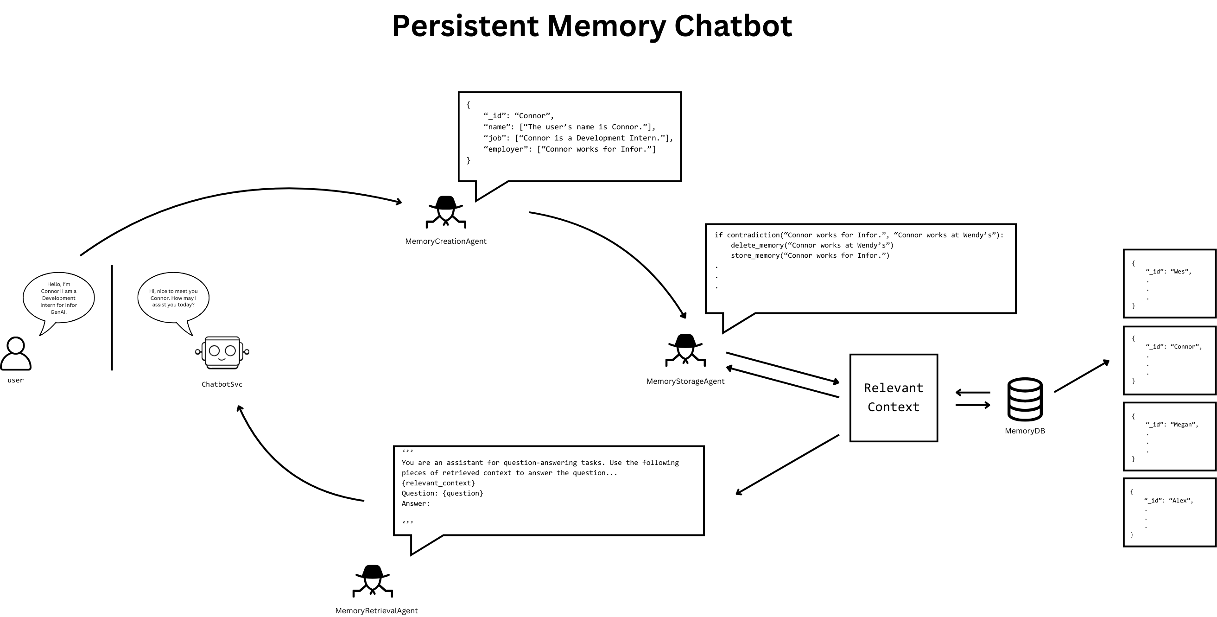

Slide 7
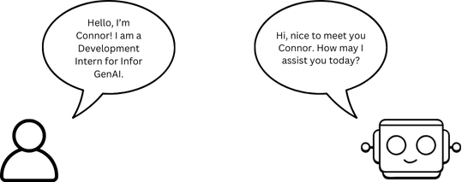
Step 0. Initial User Query

Slide 8
What does a memory look like?
Every memory is a key-value pair.
The key represent the semantic category of the memory.
e.g. name, interests, hobbies, preferences, biographical..
Unstructured user information parsed from the query is thus separated into several semantically similar groups to promote effective retrieval for Q&A purposes.
“Raw text with valuable information that should be remembered” -> {“semantic label”: “important information”}
{“semantic label”: [important information,...]} is given to the MemoryStorageAgent for storage.
It's important, what is important, valuable or worth remembering is highly influenced by the examples given in the memory creation prompt (next slide) and by the fields it is allowed to choose from. The way I have implemented memory creation is highly subject to initial conditions, so needless to a chat service like this would need careful crafting save appropriate memories.

Slide 9
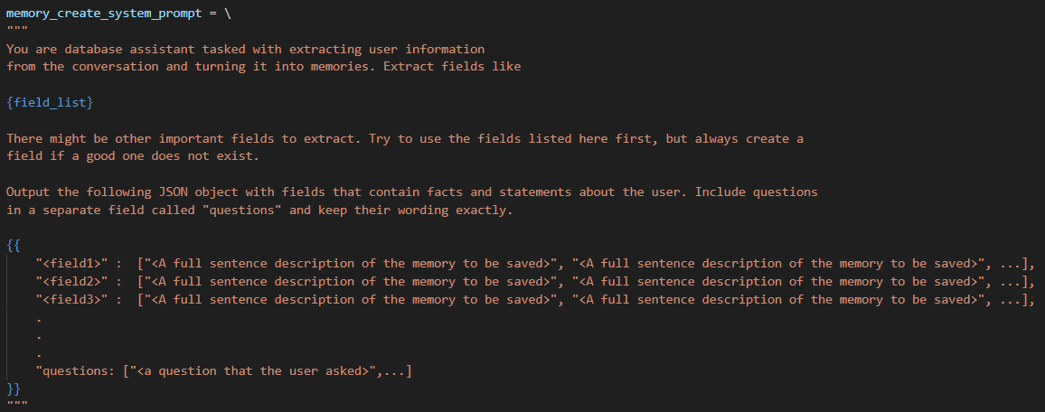
Memory Creation Prompt

Slide 10
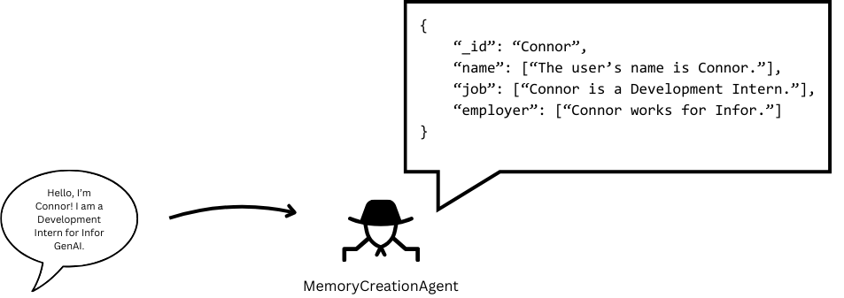
Step 1. Memory Creation

Slide 11
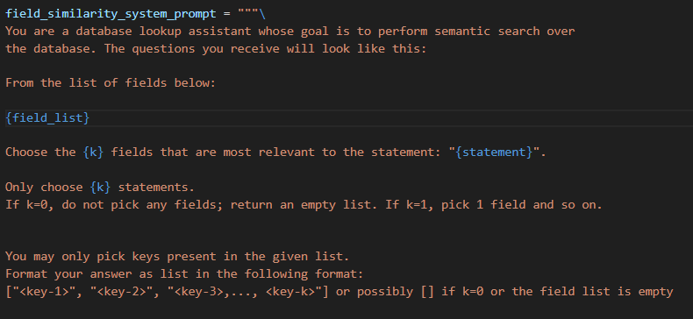
How does memory storage work?
After the MemoryCreationAgent passes off the memory payload, individual memories are checked against existing memories for contradictions. If contradictions are found, these memories are removed, and then the new memories are inserted.
An important detail to note, only statements made by users are checked for contradiction, questions are passed over during this phase.
Before contradiction-checking though, the MemoryStorage Agent first performs a semantic search by picking the fields that it deems are relevant to the user's statement. This is performed for both statements and questions to construct relevant context either for contradiction resolution or retrieval.

Slide 12
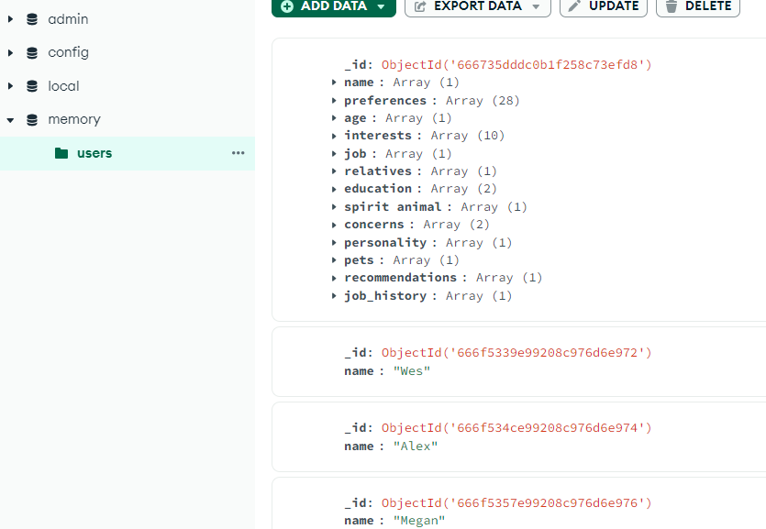
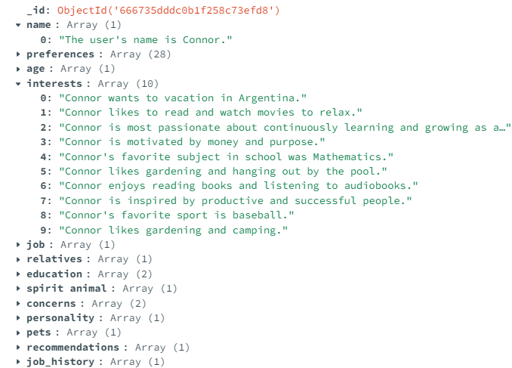
What does the MemoryDB look like?
Each document in the MemoryDB* has an “_id” correspondent with the user, for now consider “_id” and “name” to be interchangeable.
Within each document, semantic keys correspond to lists of related memories
(technically a collection called “users” within a MongoDB database called “memory”; future collections could organize information not related to user, perhaps organizational context)

Slide 13
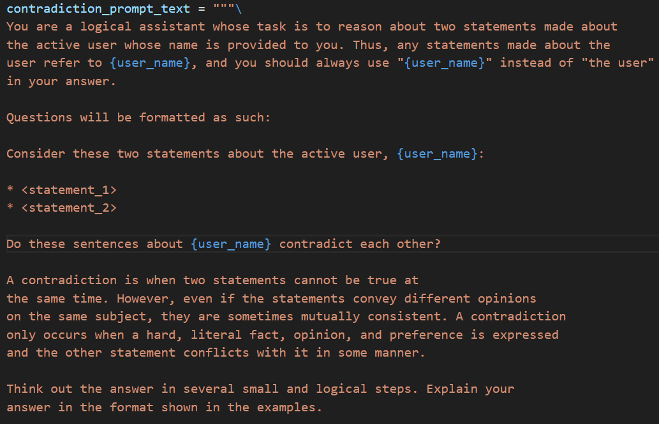
How does contradiction-checking work?
Chain-of-Thought + Multi-shot Prompting
context grounding
task description
defining key term
chain-of-thought command

Slide 14
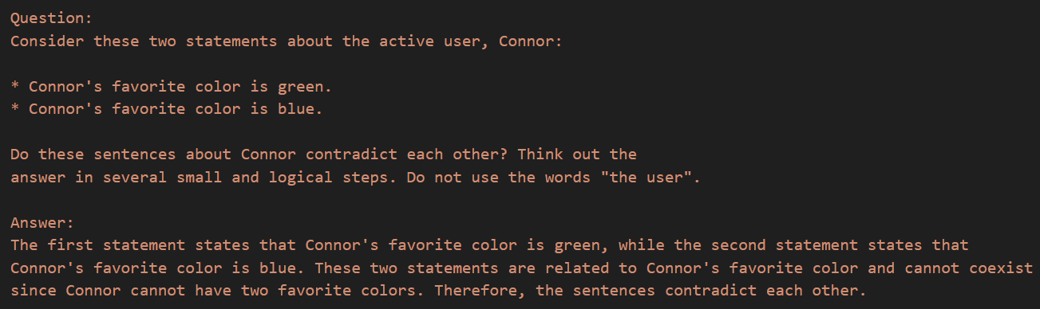
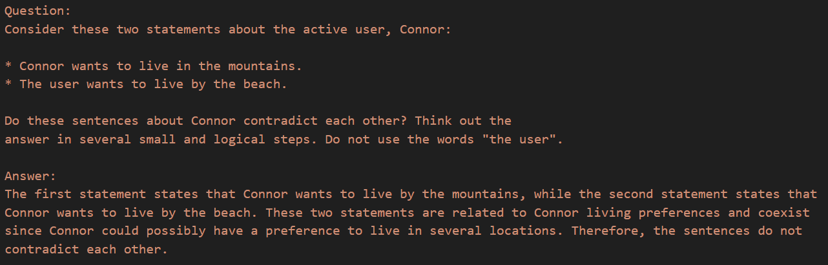
How does contradiction checking work?
Chain-of-Thought + Multi-shot Prompting
Example output to ground LLM reasoning steps for contradicting statements
Example output to ground LLM reasoning steps for noncontradicting statements

Slide 15
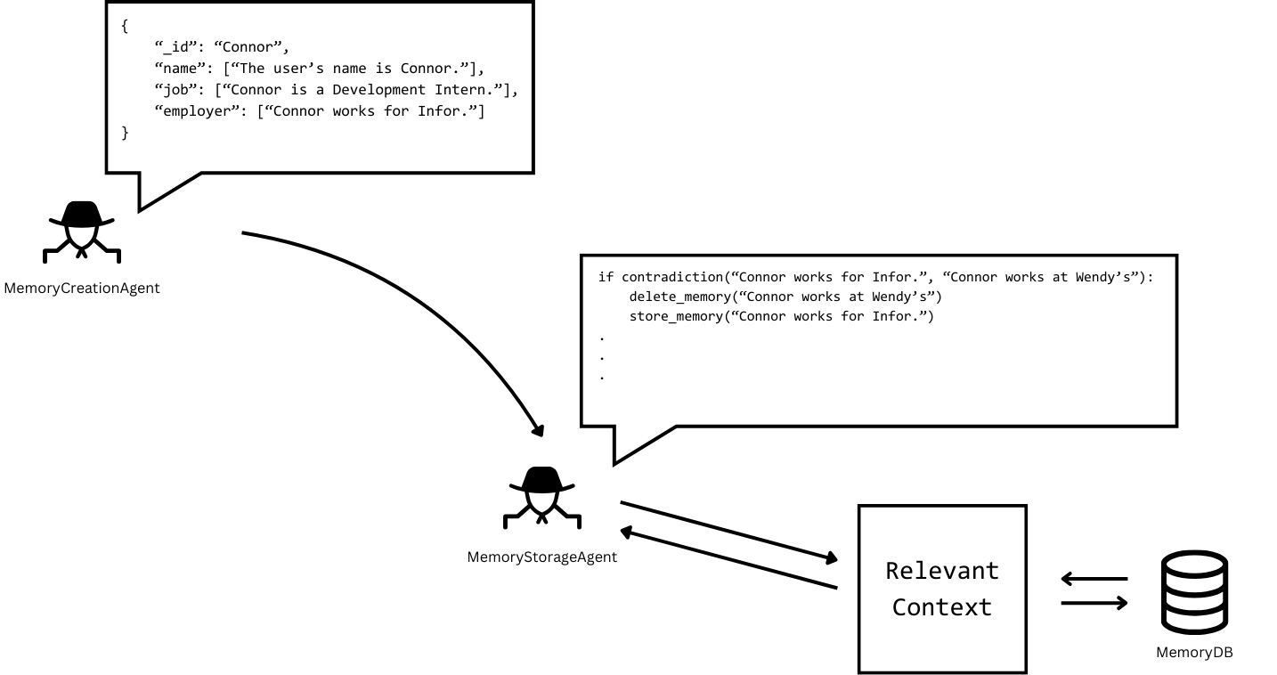
Step 2. Memory Management

Slide 16
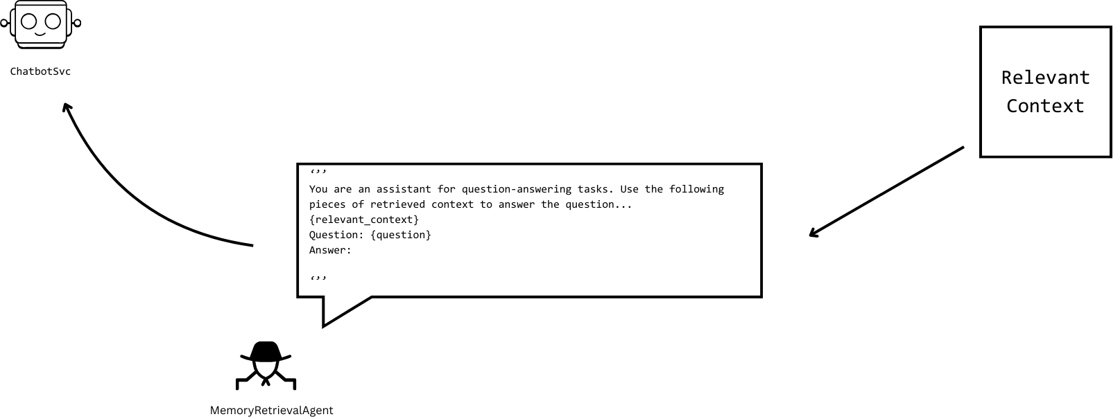
Step 3. Retrieval

Slide 17
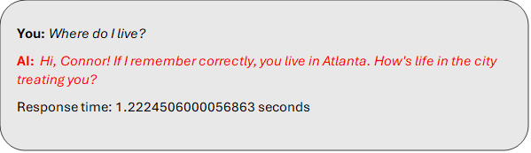
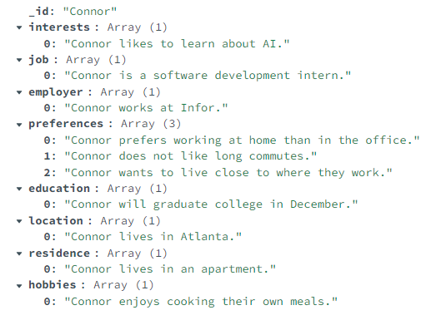
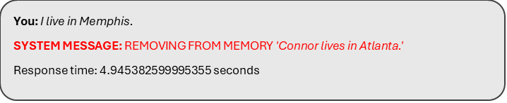
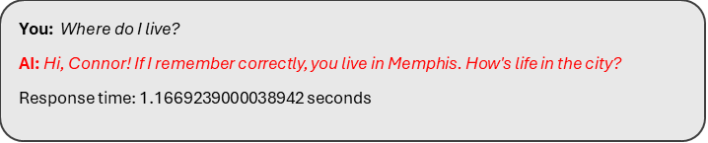
Example with Real Prompts

Slide 18
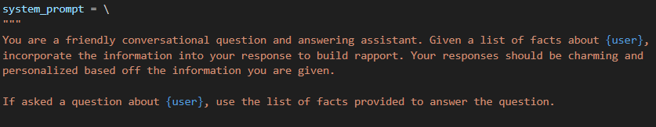
Snippet of Retrieval Prompt

Slide 19
Summary of Project-to-date
Modular development of each agent and its core responsibilities is complete.
“The hand-off”/communication between agents is still in active development.
At both ends of the pipeline, memory creation & memory retrieval still needs to be optimized.
Discussion/Question?
Is this the optimal payload formatting/database relationship between user input and persistent storage? Also, the “elephant in the room” being that embeddings databases have clear advantages for storage capacity, database operations and RAG.
What is the optimal prompt contextualization when using facts pulled from memory? Facts saved off during different sessions or about different topics when combined could be too sporadic for the LLM to utilize meaningfully. Garbage In -> Garbage Out.
What role if any should recent chat history have in the chat service like it typically does in stateful Q&A chatbots?

